Slide 1

Celebrating temperance
Notes:
It was a scene of heartrending pain and despondency—children crying as the domestic upheaval they were enduring threatened their comfort zone and emotional security; a frustrated mother, obviously emotional and angry. “This is the last straw!” the mother said to herself. “We can’t take it anymore!” Joe, the alcoholic father and husband, had lost yet another job.
A pleasant, soft-spoken man, Joe generally was a kind father and considerate husband—except when under the influence of alcohol. He also was a keen and able sportsman, well liked and welcomed into the sporting circles of his town. He always could be counted on to participate in the celebrations at the clubhouse or pub after a golf game or other sporting event. As his addiction to alcohol cost him one job after another, however, he lost not only his financial security but also the many friends with whom he played, drank, and fraternized during the “better” times.

Slide 2

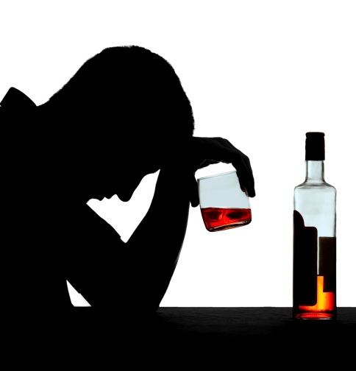
“I can control alcohol and tobacco!”
Notes:
Joe’s problem was not only with alcohol; he also smoked cigarettes. Not even the diagnosis of cancer of the larynx motivated him to stop smoking for more than a few months. Life-threatening diagnoses such as heart attack and cancer often lead to only short-term lifestyle changes. The sobering reality is that something more is needed to effect meaningful and long-term changes in our established behavior. Joe’s sad story bears witness to this pattern, described best in his own words during his numerous but short-lived periods of recovery: “I can control tobacco and alcohol; they are not my master!” The sad reality is that they were his master, and Joe was, in fact, their slave.
Joe’s difficulties as a result of his love affair with alcohol affected many others, especially those in his family. Two of his four children also became alcoholics.

Slide 3
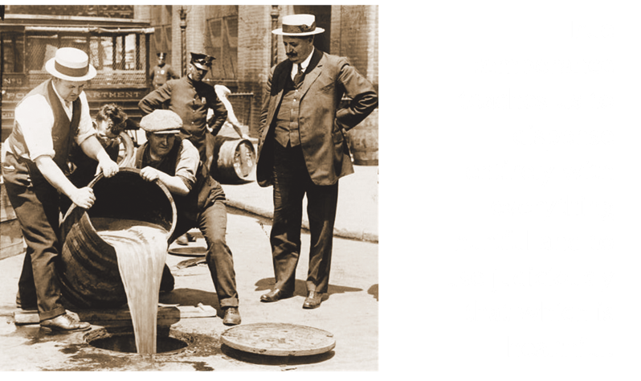
The meaning of “Temperance”
Notes:
“Temperance” means different things to different people. For some it brings to mind the times of prohibition (when alcohol was legally banned); for others, it relates to childhood and youth instruction on the importance of abstaining from alcohol, tobacco, and recreational drugs. In many cultures and communities “temperance” has become a forgotten (even anachronistic) word—a term from the past. So does it still apply to our lives today?
Webster’s Dictionary defines “temperance” as “moderation in action, thought, or feeling, or moderation or abstinence from intoxicating drink.” This definition includes aspects of behavior and attitude, and specifies that alcoholic beverages be avoided. Is this comprehensive enough? To achieve true balance in life, we need to address all aspects of living; balance in all things is needed.

Slide 4

Use judiciously that which is healthful
Notes:
A definition that may move us closer to this wholeness in our living is: “True temperance teaches us to dispense entirely with everything hurtful and to use judiciously that which is healthful.”¹ This description implies a way of life as opposed to a checklist of certain substances and behaviors, suggesting that in excess even good things may be harmful!¹

Slide 5

Is my own life in balance?
Notes:
We can benefit from taking personal stock of our own lives and assets, as to whether we are excessive in eating, working, playing, sleeping, or whatever. It’s easy to do an inventory on those around us—what others eat, drink, weigh, drive, wear, and so forth. In some societies conspicuous consumption is obvious, and we have no difficulty identifying it. It’s more difficult to analyze our personal attitudes and behaviors to determine whether our own lives are in balance.

Slide 6
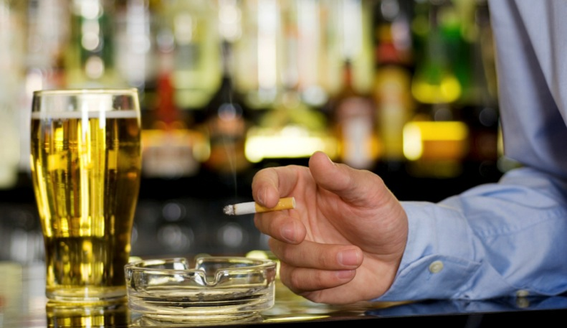
Many regard destructive habits as desirable
Notes:
What makes matters more complex is that many regard certain destructive habits and lifestyle choices as desirable and even beneficial. Tobacco and alcohol are legal and freely available with very few restrictions. As a result, they’ve become entwined in cultures and societies worldwide despite the fact that they are the leading and third-leading causes, respectively, of preventable death! The seduction of advertising as well as the stranglehold of commerce have much to do with this tragic situation, but in reality our personal choices play an important role.
One component of being able to make wise choices is the accessibility of information, so let’s look at some of the information available.

Slide 7

Alcohol consumption and global health
Notes:
Alcohol consumption varies widely between countries, depending on cultural traditions. There also is a discrepancy between developed and emerging economies. Alcohol, like tobacco, is being exported to developing countries, adding huge burdens to already inadequate health systems. According to the “Global Status Report on Alcohol and Health” released by the World Health Organization (WHO) in Geneva, February 2011:²
Approximately 2.5 million people die from alcohol-related causes each year.
Fifty-five percent of adults have consumed alcohol.
Four percent of all deaths are related to alcohol through injuries, cancer, cardiovascular diseases, and liver cirrhosis.
Globally, 6.2 percent of male deaths are related to alcohol, and 1.1 percent of female deaths.
One in five men in the Russian Federation and neighboring countries dies from alcohol-related causes.

Slide 8

Binge drinking is increasing
Notes:
The pattern of alcohol consumption is changing, as mentioned previously. Figures for 2001-2005 released by the WHO³ revealed that worldwide, 6.13 liters of pure alcohol were consumed per year, per person aged 15 years or older. This amount appeared to be stable in the Americas and the European, Eastern Mediterranean, and Western Pacific regions; however, marked increases were noted in Africa and Southeast Asia. Health risk increases even more when binge drinking occurs; in other words, when people drink to get drunk. Binge drinking may be defined differently in various regions of the world: in the United States more than five consecutive drinks for a male and more than four for a female; in Australia more than four drinks on a single occasion. Binge drinking is increasing in many parts of the world, mainly among youth, but all age groups are affected.⁴

Slide 9

Alcohol…is dangerous
Notes:
A recent book on research and public policy states that “alcohol is a risk factor for a wide range of health conditions and social problems . . . accounting for approximately 4 percent of deaths worldwide and 4.6 percent of the global burden of disease, placing it alongside tobacco as one of the leading preventable causes of death and disability.”⁵
Alcohol is no ordinary commodity and is dangerous.

Slide 10

Risks of alcohol addiction
Notes:
Alcohol is a known addictive substance. The likelihood of becoming an alcoholic (euphemistically termed “problem drinker”) depends on numerous factors. The chance of alcoholism developing over a lifetime is 13 percent (13 people of every 100 who drink alcohol). If there is a first-degree relative (father, mother, uncle, aunt, grandparent) who suffered from alcohol dependence, this percentage doubles. If experimentation with alcohol begins under the age of 14 years, the percentage chance of dependence increases to 40 percent-plus!⁶ This demonstrates the importance of alcohol education from an early age and the fostering of relationships and connectedness between responsible adults and youth. Social support develops resilience, enabling youth to cope with difficult decisions and choices despite peer pressure. An additional and vital layer of protection for both young and old is a connection to a set of values, such as the principles of the Bible and walking with the risen Savior.

Slide 11

Alcohol and cancer
Notes:
Cancer is one of the leading causes of death globally. An interesting example of the relationship between drinking alcohol and cancer comes from the European Union (EU), where cancer is the second most common cause of death, with 2.5 million cancer deaths per year. It’s estimated that 10 percent of cancers in men and 3 percent of cancers in women can be attributed directly to alcohol use. It’s further estimated that 30 percent of cancers in the EU could be prevented through more healthful lifestyle choices. The 2010 Eurobarometer Report found, however, that one in five European citizens does not believe that there’s a connection between alcohol and cancer; one in ten is totally ignorant that alcohol consumption can cause cancer.⁷ Sadly, being ignorant does not spare us the consequences.

Slide 12

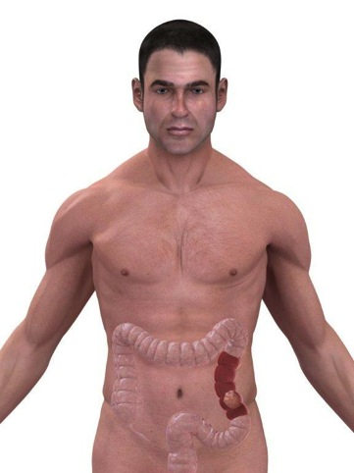
Alcohol linked to breast cancer and colon cancer
Notes:
Robust evidence links alcohol as a cause of breast cancer in women and colon cancer in both men and women. These findings have been summarized and reported in the World Cancer Research Fund’s comprehensive reports in 2007 and 2011.⁸ The point strongly emphasized in these and many other scientific reports is that there is no safe limit/dose of alcohol that can be recommended to avoid its carcinogenic effect. This raises serious doubts about any recommendation that alcohol be used for health benefits, even cardiac, because the associated side effects are real and dangerous.

Slide 13

Alcohol and safety
Notes:
It is well known that alcohol use is associated (often causally) with accidents of all kinds, such as road fatalities, as well as domestic violence, murder, rape, and other criminal activities. In 2010 Professor David Nutt and core-searchers published an analysis in the prestigious The Lancet medical journal showing that in the United Kingdom alcohol overall is more harmful than heroin and crack cocaine. This is because the researchers focused on the effect the drugs/toxins had not only on the user but others as well (family, community, and society). Heroin, crack cocaine, and methamphetamine were the most harmful drugs to individuals.⁹
Alcohol is also the leading cause of preventable mental retardation in the world. This is because alcohol readily crosses the placenta and damages the developing brain of the unborn baby. Again, there is no safe level of alcohol consumption during pregnancy.¹°

Slide 14

Alcohol and heart health
Notes:
For the past 30 years alcohol has been promoted as “heart healthy” and protective against coronary artery disease. Much has been written in the popular and scientific literature on the subject. None of the scientific studies have been controlled, randomized, prospective analyses, which makes them even more subject to what are known as “confounders.” Confounders are factors that make interpretation of the results of the data being analyzed more difficult and also may result in erroneous conclusions. Naimi and other researchers concluded in 2005 that some or all of the apparent cardiac protective effect of moderate drinking may be the result of these confounders.¹¹ Other studies have sounded caution and noted that the nondrinkers included in many of the studies had more risk factors for heart disease, were less well-educated, had less access to health care and insurance, and were from poorer socioeconomic groups. Some included in the nondrinking group had been drinkers prior to the studies being done and had stopped drinking for health reasons.¹²

Slide 15


Daily exercise and a healthful diet
Notes:
A recent paper by Dr. Boris Hansel adds weight to the view that the real explanation of positive cardiac outcomes in moderate drinkers is not that alcohol is protective, but that the average health status and healthful lifestyle in other behaviors, such as exercise and diet, are better than that of nondrinkers.¹³
In summary, taking into account the significant health risks related to alcohol use, it doesn’t make sense to promote its use for heart health, especially when there are proven and safe interventions for heart-disease prevention such as daily exercise and a healthful diet.

Slide 16

Killer tobacco
Tobacco kills nearly 6 million people each year.
Nearly 80 percent of the world’s 1 billion smokers live in low- and middle-income countries.
Notes:
Killer Tobacco
There is another lethal and freely available poison that is marketed in various forms—tobacco. It’s smoked, chewed, inhaled, and passed through water; all forms, however, are harmful and place the user at significant risk of disease and even death. It’s surprising that tobacco is so popular when you consider that it kills up to half its users!
Tobacco kills nearly 6 million people each year.
Nearly 80 percent of the world’s 1 billion smokers live in low- and middle-income countries.

Slide 17
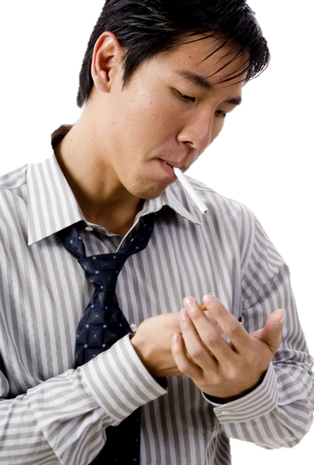
Consumption of tobacco products is increasing globally.
Approximately 1 person dies every 6 seconds as a result of tobacco-related causes.
Up to half of current users will eventually die of a tobacco-related disease.
Notes:
Consumption of tobacco products is increasing globally.
Approximately 1 person dies every 6 seconds as a result of tobacco-related causes.
Up to half of current users will eventually die of a tobacco-related disease.

Slide 18

Tobacco is a gradual killer
Notes:
Tobacco is a gradual killer. There’s a lag of several years between initiation of tobacco use and when the user’s health suffers. It’s one of the most significant public health threats the world has ever faced, killing not only the user but often negatively impacting the health of, or even killing, those who are exposed to secondhand tobacco smoke.
Secondhand smoke (SHS) by definition is the smoke that fills restaurants, offices, homes, and any enclosed space in which tobacco products including cigarettes, cigars, pipes, bidis, and water pipes (shisha) are burned. There is no safe level of exposure to secondhand smoke. It’s a proven cause of cardiovascular and respiratory disease in adults, including lung cancer and coronary heart disease. SHS also is associated with Sudden Infant Death Syndrome (SIDS) and causes low birth weight in pregnant women. Children exposed to SHS have an increased incidence of upper- and lower-respiratory infections.

Slide 19

Tobacco, a “gateway drug”
Notes:
All these complications, both from primary inhalation of tobacco smoke and SHS exposure, result from the many toxins, chemicals, and nicotine in tobacco smoke. There are more than 2,000 chemicals in tobacco smoke; at least 250 of these are known to be harmful, and more than 50 are known carcinogens (initiate cancer).
Tobacco is a “gateway drug.”¹⁴ This means that people who are exposed to tobacco are on the threshold of using and becoming addicted to other drugs, such as marijuana, methamphetamine, cocaine, and heroin. This is particularly significant when considering tobacco use by young people, which is becoming more common in many parts of the world. The age of debut is getting younger, as well. Long-term addiction to tobacco is also more likely when individuals initiate smoking at a young age.

Slide 20
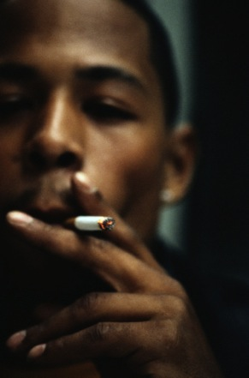

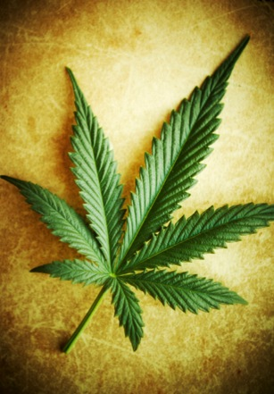
Avoid all things harmful!
Notes:
In summary, both alcohol and tobacco are extremely dangerous substances. Scientific evidence and public health statistics show them to be leading killers in the world today. Of course, it’s left to one’s personal choices as to whether to indulge, and this is where temperance has such a wise safeguard: avoid all things harmful! The facts surely speak for themselves.

Slide 21

True balance in living
Notes:
Joe’s story reveals the consequences of failing to avoid all things harmful. As we take stock of our own lives there may be areas in which we lack balance such as sleeping too little, working too hard, not exercising enough (or maybe overdoing it), eating too much, and the list goes on. We may even abuse social media or the availability of the Internet with its seductive and misleading pornography menus. These forms of technology are good in themselves but potentially addictive when not used judiciously. Even the most strong-willed among us is unable to achieve true balance in all things without a strong reliance on the power of our gracious and Almighty God, who not only made us but is able to sustain us and strengthen our will and ability to make wise choices.

Slide 22


I can do everything through him who gives me strength.
Phil. 4:13, NIV
Notes:
Remember Paul’s counsel in Scripture: “Whether you eat or drink or whatever you do, do it all for the glory of God” (1 Cor. 10:31, NIV). Realizing that this is a very tall order, Paul fortunately adds the secret of power and success: “I can do everything through him who gives me strength” (Phil. 4:13, NIV).
It’s encouraging to remember that help is never far away. “[God] is not far from each one of us. For in him we live and move and have our being” (Acts 17:27, 28, NIV). Our gracious heavenly Father stands ready to guide our choices, ensuring a sustained and successful true balance in life. This calls for celebration.

Slide 23

LIFE APPLICATION QUESTIONS
Notes:
LIFE APPLICATION QUESTIONS

Slide 24

A group of boys and girls from a local church school attended a party at which binge drinking occurred. Unfortunately, they found the alcohol in the church member’s home.
Notes:
A group of boys and girls from a local church school attended a party at which binge drinking occurred. Unfortunately, they found the alcohol in the church member’s home.

Slide 25
If I were asked to give regular talks at the school on the dangers associated with alcohol, which of the facts in this chapter would I emphasize?
Is my example of temperance one they should follow?
Notes:
If I were asked to give regular talks at the school on the dangers associated with alcohol, which of the facts in this chapter would I emphasize? Is my example of temperance one they should follow?

Slide 26

Have I been influenced by articles that purport that drinking a little alcohol is beneficial to the cardiac system?
What other negative consequences of alcohol use mitigate those reports?
Notes:
Have I been influenced by articles that purport that drinking a little alcohol is beneficial to the cardiac system?
What other negative consequences of alcohol use mitigate those reports?

Slide 27

If I were to drink only socially, what are my chances of becoming addicted?
Notes:
If I were to drink only socially, what are my chances of becoming addicted?

Slide 28
Do I have a first-degree relative who has suffered from alcohol dependence?
If so, how would that affect the risk I would be taking?
Notes:
Do I have a first-degree relative who has suffered from alcohol dependence? If so, how would that affect the risk I would be taking?

Slide 29

How can I reduce the chances of children and youth in my home, church, or community being pressured by their peers into experimenting with tobacco, alcohol, or other drugs?
Notes:
How can I reduce the chances of children and youth in my home, church, or community being pressured by their peers into experimenting with tobacco, alcohol, or other drugs?

Slide 30

Do I know their names and greet and interact with them?
Notes:
Do I know their names and greet and interact with them?

Slide 31

Do they know and respect me enough to think that they would disappoint me if they were to indulge in these behaviors?
Notes:
Do they know and respect me enough to think that they would disappoint me if they were to indulge in these behaviors?

Slide 32

What things in my life are out of control, unbalanced, or used injudiciously?
How do I know if I am working too much, sleeping too little, eating too much, or exercising too little?
Notes:
What things in my life are out of control, unbalanced, or used injudiciously? How do I know if I am working too much, sleeping too little, eating too much, or exercising too little?

Slide 33

How do I make judicious use of my free time?
Notes:
How do I make judicious use of my free time?

Slide 34

Am I spending too much time with electronic media and too little time cultivating good relationships with my Savior and people close to me?
Notes:
Am I spending too much time with electronic media and too little time cultivating good relationships with my Savior and people close to me?

Slide 35

Do I set aside time for service to those less fortunate?
Notes:
Do I set aside time for service to those less fortunate?

Slide 36

When I realize the need for change, do I remember the One who can give me the strength I need?
Do I ask for that enabling power?
Notes:
When I realize the need for change, do I remember the One who can give me the strength I need? Do I ask for that enabling power?

